Slide 1
USHER SYNDROME:
IEP CONSIDERATIONS
Presented by:
Lanya McKittrick, PhD

Slide 2
Objectives
Overview of Usher syndrome
Challenges
Strategies and Supports
Resources

Slide 3
What is Usher Syndrome?
Most common genetic cause of combined vision and hearing loss (all ages)
Rare, or orphan disease
1858- First described by German ophthalmologist
1914 – Named for Charles Usher, British ophthalmologist who completed first definitive study
Autosomal recessive
Affects both males and females
More common in some communities
Notes:
Usher Syndrome is the most common genetic cause of combined vision and hearing loss for all ages.
It’s considered a rare or orphan disease.
It was first described in 1858 by a German ophthalmologist.
Then in 1914 the condition was named for Charles Usher, the British ophthalmologist who completed the first definitive study for Usher.
It is considered an autosomal recessive disorder. If both parents are carriers of the gene, the children have a 1 in 4 chance of having Usher.
Usher affects both males and females. It is more common in certain communities such as the Jewish and Cajun communities.

Slide 4
How does Usher Syndrome Present Itself
Hearing: Born with or develop hearing loss
Vision: Progressive vision loss due to retinitis pigmentosa (RP),
Light-sensing cells in the retina gradually deteriorate
Night blindness first
Low peripheral vision (“tunnel vision”)
Balance: Vestibular issues are present in some genetic subtypes of Usher
Notes:
Usher syndrome presents itself differently depending on the individual and the type of Usher syndrome (which I will get to in a few slides). But there are some common characteristics.
-Individuals with USH are born with or develop hearing loss over time.
-Vision loss is progressive due to RP, where light sensing cells in the retina gradually deteriorate.
-Night blindness occurs first, which is when brings most people into the eye doctor, thinking there is something wrong
-Vestibular issue which are present in individuals with Usher type 1. For children who have Usher type 1, they often have delays in sitting, crawling and walking. My son didn’t walk until he was age 2. So, I tell parents of children who are D/HH that notice balance issues early on, that they might want to pursue genetic testing.
-Later, individuals experience low peripheral vision (or tunnel vision). Next I’ll show some examples of what I mean.

Slide 5
Normal night vision

Slide 6
Night vision with Usher syndrome

Slide 7
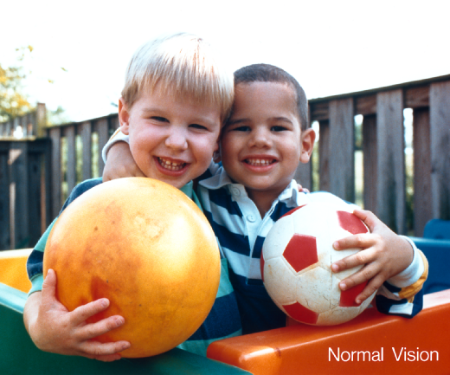
Retinitis Pigmentosa
Image credits: National Eye Institute
Notes:
Blind spots

Slide 8
Hearing Loss
Often congenital (present at birth)
Bi-lateral (both ears)
Sensorineural (no structural damage to ear, only to sound-sensing hair cells inside the cochlea)
Mode of communication is a very personal decision (such as ASL, tactile sign language, SEE, cued speech, spoken language, cochlear implants, hearing aids, or a combination)
Notes:
The hearing loss is often congenital (present at birth), bilateral (meaning both ears), sensorineural, meaning no structural damage to the ear itself - only to the sound-sensing hair cells inside the cochlea. I’ll be showing a short video clip in a moment to describe.
Families and individuals have decisions on how they prefer to communicate - it’s a very personal choice.
-Some communicate using American SIgn Language. Or tactile sign language for individuals who have less vision. Or SIgning Exact English with or without speech (Total Communication).
-Others use cued speech - a method of communication in which the mouth movements of speech are combined with a system of hand movements
-And other use spoken language - with the help of hearing aids or cochlear implants or a combination. A cochlear implant is very different from a hearing aid. Hearing aids amplify sounds so they may be detected by damaged ears. Cochlear implants bypass damaged portions of the ear and directly stimulate the auditory nerve. My children hear with the help of cochlear implants and use spoken language. But, again, this is a very personal decision and as you work with these families, it’s important to understand the communication mode they have chosen. This is especially important to understand as you develop an IEP and think about placement and services because the needs vary depending on individual communication preferences and abilities.
Our team from the deafblind project has experience and can help your IEP teams understand communication and hearing loss and how to best support a child in the classroom.

Slide 9
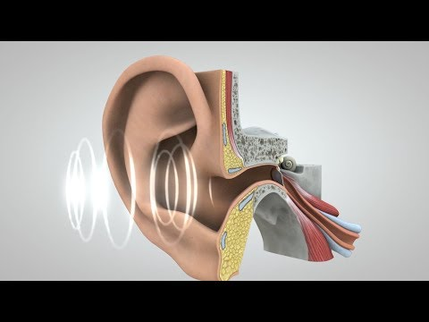
Journey of Sound

Slide 10
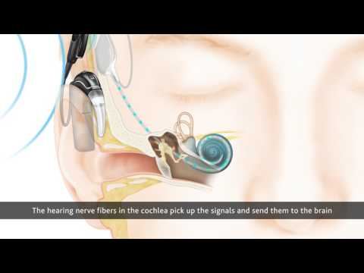
How a Cochlear Implant Works

Slide 11
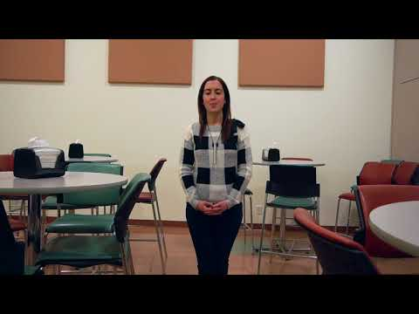
Hearing Loss in the Classroom

Slide 12
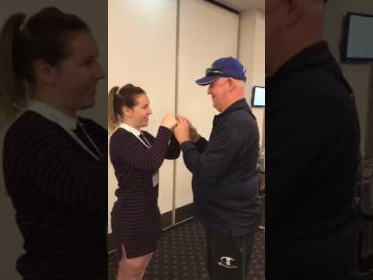
Tactile Sign Language

Slide 13
Clinical Types of USH
Type 1 (B, C, D, F, G) | Type 2 (A, C, D) | Type 3 (A, B) | Atypical
Deaf early (often birth) | Mod/severe high frequency hearing loss, progressive | Progressive hearing loss | Gene present
Early onset RP | RP evident in teens | Progressive vision loss. | Symptoms are absent or do not fully express
Late to walk | No balance issues | Progressive balance loss in 50%
Notes:
Going back to the different types of Usher syndrome, I have a chart on the screen showing the different types (1, 2, 3, atypical) and subtypes (such as Type 1B - which is my children have). There are more and more subtypes of Usher syndrome being identified all the time as doctors learn more about genetics.
It’s important to note that genetics testing is the only sure way to confirm this diagnosis. Foundation Fighting Blindness offers free genetics testing. I’ll be sharing a link at the end of the presentation.
Usher Type 1, which is what my children have, typically presents as being identified as profoundly deaf early (often at birth), an early onset of RP (We noticed night blindness at the age of 3 and my oldest son was legally blind at age 16 but this varies by individual). My 13 year old has some night blindness and blind spots but his peripheral vision is pretty in tact right now. Children with US1 are also late to walk, which I described earlier.
Usher Type 2, is characterized by a moderate to severe high frequency hearing loss - a progressive hearing loss. RP becomes evident in their teens and they will typically not be legally blind until their 20’s to 40’s. Again, it’s very individual. Individuals with Usher 2 do not typically have problems with balance.
Usher Type 3 is characterized by both a progressive hearing loss and vision loss. Some individuals may have problems with balance - about 50% of those with Usher 2.
There is also an atypical type in which the gene is present but symptoms are absent or do not fully express. As we learn more about genetics, we learn more and more.
The important thing to know is that there are subtypes under each of the types (for instance for type 1, the currently known subtypes are Usher 1B, C, D, F and G). Each subtype relate to a different gene, which makes it like each subtype almost like a different disorder. Research for a cure for Usher syndrome typically is by subtype - by gene - and each gene has different characteristics. So, for a family with Usher 1b, there is a different gene, than Usher type 1f. This means that there is different research toward a cure and slightly different ways that the syndrome expresses itself.
So, for families with Usher, this can make it feel like the disease is even more rare.

Slide 14
Frequency of USH
Estimates vary
At least 25,000 people in the United States
400,000+ worldwide
National Deafblind Child Count (2020)
updated annually
11,407 deafblind children served by states
413 with Usher in US
285 deafblind children served in WA
12 USH children served in WA
Notes:
The Usher syndrome Coalition estimates that there are at least 25K in the US and over 400K worldwide.
The National Center on Deaf-Blindness and the State DB projects conduct a child count each year. In 2020, there were 11,407 deafblind children served by states, 413 with Usher in the US. There are 285 deafblind children served in Washington state - 12 have USH.
There are significantly more children that are not yet in the childcount and are not yet counted. It is important to be counted so that we can ensure the services and supports for these children.

Slide 15
Challenges

Slide 16
Difficulty finding children and adults with USH
Most medical professionals don’t know about Usher syndrome
Children with Usher are mainstreamed or in local school with supports and classified as D/HH
Their vision issues are not yet serious OR
No one has realized “vision loss + hearing loss may equal Usher syndrome” OR
Parents know but haven’t told the child yet
Gene not yet identified
May not be connected with State DB project – not in child count.
May not have connected with the USH Coalition
Notes:
Why is this? We don’t know for sure - there are many things that contribute.
Because it’s so rare, most medical professionals don’t know about Usher. When they see things like children missing developmental milestones for walking, they don’t think to refer them to a specialist or for genetics testing. This is getting better with the advances of genetics testing but it’s still an issue.
Children with Usher are often mainstreamed or in a local school with supports. Because their vision loss may not present until later, these children may be classified as D/HH and not have started to receive vision services yet or be classified as DB on their IEP.
Usher might be suspected but the gene might not have been identified for that child.
The child may not be connected with their state DB project so not in the child count. This situation is what I was talking about previously about the discrepancy in numbers.
They may not have connected with the Coalition and be in our registry.
All of this is important because we can’t provide services and supports if we can’t find everyone. Having access to more individuals also helps pharmaceutical companies and researchers prioritize research towards a cure. With increased numbers, comes more hope for our community for a cure. There are many adults with Usher that haven’t yet been only clinically diagnosed and not received genetics testing. These individuals are often not in our counts.

Slide 17
Heterogeneous
Communication mode varies (ASL, Tactile, Hearing aids, Cochlear Implants, combination)
Hearing and vision loss impacts vary depending on situation
Vision loss is progressive and varies by type / person, also depends on situation
Balance
Other disabilities
What worked for one child may not work for another
What worked yesterday, may not work today
Notes:
Another challenge is that Usher syndrome is heterogeneous. Not only is it clinically and genetically heterogeneous, it is heterogeneous when we think about how the deafblindness impacts a child in the classroom.
As I mentioned previously, communication modes vary. A child who uses sign language, for instance, will have different needs than a child who uses listening/spoken language. But it may be more complicated than that. A child may use different communication modes depending on the situation. For instance, sometimes children who have cochlear implants or hearing aids and primarily use spoken language, will find they would benefit from a sign language interpreter and/or captioning in the class. I hear this a lot when a child is fatigued, for instance. I heard this a lot in the pandemic, where children found they needed to rely on multiple methods of communication in order to keep up with the curriculum.
Hearing and vision can have different impacts depending on the situation. For instance, in the video I showed earlier, in a quiet well lit classroom, a child may not have as many impacts as if in a classroom with chairs moving, lots of talking, air conditioners running, with a child experiencing a lot of glare or poor lighting. It will also depend on how tired a child is or what else is going on in that childs life.
For a child with Usher, vision loss is progressive and hearing loss may be too. So, again, what worked yesterday might not work today. So, it requires collaboration and problem solving to continually adjust things.
Balance can be impacted differently from person to person as well. My younger son has much better balance than my older son, and they have the same type of Usher. Also, in dim lighting etc. balance can be worse, or if they are fatigued they may not be able to rely on their other senses as much.
A child may have other disabilities in addition to deafblindness. Many kids have sensory processing issues, ADHD, learning disabilities, and more.
In a nutshell with all of this, “what worked for one child may not work for another” and “what worked yesterday for one child, may not work for them today”.

Slide 18
The Diagnosis
Double diagnosis
Grief doesn’t end at diagnosis
Feelings of isolation
Unsure what the future holds
Rare - hard to find information, other families
Hard to find others who understand
Notes:
Another challenge is the diagnosis. It’s important to understand some background of what parents may be experiencing because their grief cycle may feel a bit like a roller coaster.
First, these families often receive a double diagnosis. Often families notice the hearing loss first, and then later find out about the vision piece - the Ushers. It’s a double whammy for parents and you feel like just when you get out of the grief cycle, you find out more.
The grief continues because the vision (and sometimes hearing) loss is progressive, so you are always grieving a loss of your senses. The grief is not linear and feels like a roller coaster you can’t get off of. Still today, 20 years later, I still have bad days when the grief hits me because I’ll notice that my child’s vision has declined again. Or I won’t have an answer to how to help him with some new thing that popped up for him. Because Usher can impact everyone differently, the future feels uncertain, which adds to the grief.
Usher is rare so it’s hard to find information and find other families/individuals. That’s where the Usher Syndrome Coalition can help. When my oldest son was diagnosed, the Coalition didn’t exist and it was very difficult to connect with others. This is different today but it’s still hard.
And lastly, it’s hard to find others who understand what you are going through.

Slide 19
Usher Syndrome Specific IEP Experiences
Professionals misunderstanding needs
Need to push for services
How to foster student self-advocacy/self-determination
Lack of access to other families
Emotional impacts
Impact on entire family
(McKittrick, 2019)
Notes:
In a past research study I conducted, I interviewed parents of children who are deafblind about their IEP experiences. What I found is that these parents, in addition to some of the other common challenges that parents face in IEP meetings, had some Usher syndrome specific challenges.
The challenges common to other parents include: IEP meetings being stressful, especially during transitions, the special education system being overwhelming and confusing, feelings of power imbalance between parents and other IEP team members, and the resulting conflict that can occur when parents feel their voices aren’t heard.
For families of children who have Usher syndrome, parents reported some common challenges:
The first is that families feeling like professionals often misunderstand their childs needs. This happens because of the reasons I talked about when I mentioned how heterogeneous Usher syndrome is.
Families feel like it’s up to them to push for services, especially for those that they feel like will help their children in the future. (such as Braille, O&M, etc).
Families report that IEP experiences improve if they are able to involve their child in their educational planning. This is possible if we are able to foster a childs self-advocacy and self-determination skills.
Parents in my study shared how hard it is to connect with other families, the emotional impacts of the diagnosis and constantly advocating, and that these impacts are felt by the entire family, not just the parents.

Slide 20
Parent Reported Experiences
Team not understanding and valuing different communication modes
Collaboration among large team of service providers
Transitions
Constantly changing needs /environments
(McKittrick, 2019)
Notes:
Parents also shared how IEP team members often did not understand and value different communication modes. I talked a bit about this when I mentioned that communication mode is a very personal decision, and how an individual may use multiple modes of communication, especially when fatigued.
For Usher families, their IEP teams are often quite large, which requires strong collaboration.
Transitions are a big challenge for families, not just at age 16 as most of us think. But, when a new IEP team member is added, when there are new gen ed teachers, new school year, etc. This is why many families create “About me” one pagers and do in-services to explain Usher syndrome and their childs unique needs.
The support needs could be different in various environments. For instance, in a well lit, quiet environment when a child is not fatigued, fewer accommodations might be necessary. But if this isn’t the case, the child may benefit from things like larger print, closed captioning, and more.

Slide 21
Strategies and Supports

Slide 22
How to support families
Educate yourself - even asking parents
Meet families where they are - relationship building
Have a conversation about their needs - or just listen
Let them know you’ll be there when they are ready.
Empower families to be strong advocates
Connect families with organizations
Connect them with other families and adults
Provide resources
You don’t need to know it all - just collaborate.
Notes:
I want to offer some strategies for supporting families. I’m sure you are doing many of these things already so these will likely be reminders.
First, educate yourself about Usher syndrome - being here today is a great step in doing that. And then don’t be afraid to ask parents because as I stated earlier, each child has unique needs. Just because you may have worked with a child with Usher before, doesn’t mean that what worked for them will work for a different child.
Meet families where they are - build those strong relationships. They may not be ready for resources or certain supports yet and that’s ok. Use a conversational approach with them to figure this out and let them know you’ll be there when they are ready.
Empower families to be strong advocates.
Connect families with organizations that can support them. I’ll be sharing resources at the end of this presentation.
Find ways to connect them with other families and adults with Usher.
Provide resources, again, when they are ready.
And just remember that you don’t need to know it all. If a family sends you an email with a question, it is ok to say you don’t know and that you’ll have to research it. Collaboration is key.

Slide 23
IEP Strategies (1 of 2)
Ensure someone with Deafblind specific expertise is on the IEP team
Communication - Encourage parents to share knowledge about unique student needs and DB
Understand it’s not just deafness + blindness (dual sensory)
Facilitate in-service about Deafblindness/Usher syndrome
(McKittrick, 2019)
Notes:
These are some strategies that the families shared with me as part of my research study:
Ensure someone with deafblind expertise is on the IEP team. If there isn’t one in your district, you can reach out to our deafblind program staff and we can provide technical assistance. Or if you are in another state, we can refer you.
Encourage and make parents feel comfortable sharing knowledge about their child’s unique needs and deafblindness. Make sure they feel like they play an important role on the team.
Understand that the impacts of deafblindness is not just deafness PLUS blindness. When a child has a dual sensory loss, I like to think of it as deafness TIMES blindness.
Help families with an in-service about deafblindness/Usher syndrome, involving the child when you can.

Slide 24
IEP Strategies (2 of 2)
Ensure appropriate goals - not lowered expectations
“honors classes are not appropriate for children like yours”,
“your child does not have the communication skills necessary to [do what the other kids are doing],
Future focus – when to start O&M/Braille, Expanded Core Curriculum
Help students be strong self-advocates
Give yourself grace - parents don’t expect you to have all the answers
(McKittrick, 2019)
Notes:
Ensure the IEP team creates appropriate goals. Many parents have told me that they felt like IEP teams often lower expectations for their children and underestimate what is possible. I heard things like “honors classes are not appropriate for children like yours”, “your child does not have the communication skills necessary to do this task”. I also hear a lot about not enough future focus on goals. This is especially true for young children who may not be legally blind but the parents know that they need Braille, O&M, assistive technology, etc. in the future. Also, families often don’t know what the expanded core curriculum is and once they become knowledgeable, they often are interested in including goals in these areas.
Helping students self-advocate for themselves. I was in an IEP meeting when my son was 9. I was advocating for a teacher of the deaf to be added to the team. I was getting push back and I was really frustrated. I was seeing my son in tears each night, needing more support. But, I couldn’t get the team to understand because what they were seeing at school was very different than what I was seeing at home. I took a deep breath and thought I’d work with him so he could explain it himself in his meeting. He shared his concerns and the team better understood. As a result, he got what he needed. And, I felt great that I was able to step back and just support him in his advocacy.
Give yourself grace, parents don’t expect you to have all the answers.

Slide 25
USH in the Classroom
Many USH students are in a gen ed classroom
Not a one size fits all approach
Seating
Pre-teaching concepts
Check for understanding - Students don’t know if they missed something if they didn’t hear or see it
Auditory and visual fatigue
Fatigue may be worse at year goes on
Parent communication!
Balancing services/needs - future/current
Accommodations are vital
Ava’s Voice Accommodations List
Notes:
What does Usher look like in the classroom?
Many children who have Usher are in a gen ed classroom. To be able to access the gen ed curriculum with their peers, they need services and supports. It’s not a one size fits all approach and due to the progressive vision and learning loss, services and supports will need to be constantly evaluated and readjusted.
Determination of Proper seating in the classroom is a team effort. Depending on the classroom and childs needs, there is likely not a clearcut answer. For the hearing loss, they may need to be seated close to the interpreter or in the center of the class so they can hear their peers better. However, this might not be the best place to allow the best visual access.
Preteaching is helpful for these children and checks for understanding. Because students don’t know if they missed something if they didn’t hear or see it. This is what was happening for my son when he was in 4th grade. He was smiling and happy at school but he was lost. The teacher would ask him if he needed help, and he didn’t think he did because he didn’t know what he had missed. So, it’s knowing how to ask detailed questions - checks for understanding that really help you determine if the child is missing information. If you just ask if a student has any questions, they may respond no but they still may have missed a lot of verbal or visual information. If, on the other hand, you ask them to repeat what their assignments are, you may realize they may not have understood.
Balancing services and needs can be challenging. I talk a lot to newly diagnosed families who want all the services right away. I totally understand that need but it’s also important to make sure they are able to enjoy those early years with their child. And that children aren’t pulled out so much that they miss out on time with their peers.
One of the biggest challenges is auditory and visual fatigue. If you recall me talking about it’s deaf x blind. I believe the fatigue can often be compounded as well. I did a study on the impact during COVID and auditory and visual fatigue as a major finding. Also, fatigue may get worse as the year goes on. Things might sail through just fine until around Winter break and then after coming back from break, things start to break down. My youngest son is experiencing this now, in fact. When he’s fatigued, all systems that we have in place, start to break down very quickly. It’s important to have a plan in place for when this happens.
This is where accommodations come into play - they are so vital and I find that it’s so helpful to look at these constantly, not just at an annual IEP meeting. On the next slide I’ll be sharing a great accommodation resource.

Slide 26
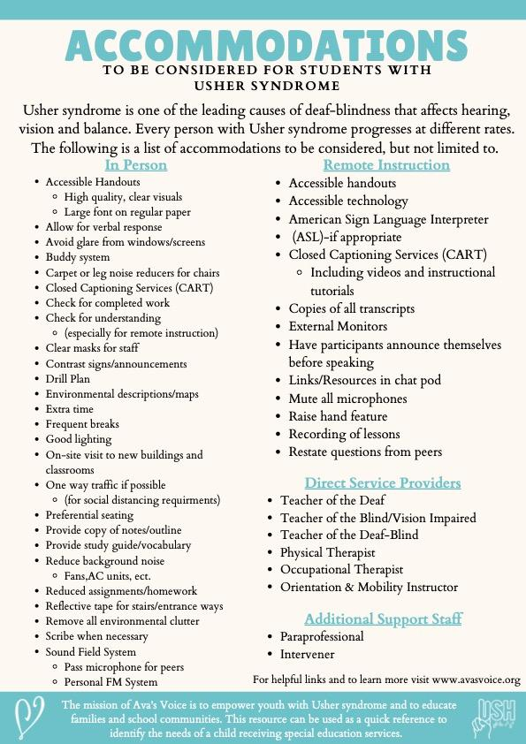
Notes:
Here’s an accommodation resource from our friends at Ava’s Voice. I know this is small font and you likely can’t read the details but I really like this resource. It gives ideas for accommodations. It’s broken down between “in-person” and “remote instruction”. It also lists some of the common direct service providers and additional support staff. This resource can be found using a link on my Lane of Inquiry website or on Ava’s Voice’s website.

Slide 27
Usher Specific Resources

Slide 28
Usher Syndrome Coalition
Building the worldwide Usher community
Website - the source of information on Usher syndrome
Focus on Usher syndrome, worldwide, all ages, all types
Provide information, resources and support
Do not fund research
Bridge between research community and Usher community
USH Trust Registry
www.usher-syndrome.org
Notes:
The Usher Syndrome Coalition is a repository of resources and support with those with Usher. We are focused just on Usher worldwide - on all ages and all types. We provide information, resources, and support. We don’t fund research but we serve as a bridge between the research community and the Usher community. The Coalition connects families and individuals together as well. If you have families you work with, I’d encourage them to sign up for the USH Trust Registry (our patient registry) and to get on our mailing list. We use the registry to let individuals know about clinical trials and we use it to connect our community and get relevant resources out.

Slide 29
USH Information
USH Connections Conference
USH Blue Book - email group for individuals with Usher syndrome.
Genetic testing resources (US only)
USH Talks - short webcasts about Usher research and related topics
Information in ASL
USH Blog – individual reflections
USH Ambassadors - building the community in their state or country
Notes:
Here are links some info that we feel is relevate: We put on an annual conference. Have an email group for our community called the USH Blue Book, and have info on genetics testing (including a link to free genetics testing for families. We have USH Talk - or short webcasts about relevant topics, information in ASL format, a blog. We also are building our community of Ambassadors and we have

Slide 30
Young Adults with Usher Syndrome
Young Adults Living with Usher Syndrome FB page
Just for Young Adults section of the website
Young Adult Blog – individual reflections

Slide 31
Children with Usher Syndrome
USHThis Summer Camps - Ava’s Voice
USHangouts - at annual conference
USC Mentor Program - coming soon

Slide 32
Collaboration -
National USH Partners
Ava’s Voice - one-week summer camp for youth with Usher syndrome; supports for parents and families; excellent educational resources
Hear See Hope Foundation/Lane of Inquiry - raising awareness for Usher syndrome; funds research, Lane of Inquiry focuses on special education DB research, family support
Usher 1F Collaborative - finding a cure for Usher 1F
Usher Syndrome Society - using photo- and videojournalism to raise awareness about Usher syndrome, funds research

Slide 33
National Resources
National Center on Deaf-Blindness
National Family Association for the Deaf-Blind: - Family to Family Community Calls
State Deaf-Blind Projects for children birth to 21
Helen Keller National Center for Deaf-Blind Youth and Adults

Slide 34
Contact
Lane McKittrick
lane@laneofinquiry.org
Newsletter Sign up: http://eepurl.com/hjOT8X

